Slide 1
COMP 3100
Week 13 - Monday

Slide 2
Last time
What did we talk about last time?
Scheduling
  Tasks
  Gantt charts
  Critical path method

Slide 3
Questions?

Slide 4
Project 4

Slide 5
Execution and Control

Slide 6
Management in traditional projects
In traditional projects, managers hire people and make sure they're trained for the project
Managers dictate quality assurance processes, data collection practices, risk monitoring, and other work processes
Managers might delegate responsibility to people in charge of some of these processes

Slide 7
Management in agile projects
Agile teams might be new for a project or existing from previous projects
Agile methodologies like Scrum often require training so that people know how to work in the agile environment
  Managers are responsible for this training
The details of applying Scrum (or whatever agile methodology) are left up to team members (non-managers)
Management is usually much more decentralized in agile

Slide 8
Control in traditional projects
Managers have to track progress
  If a task is done early (sometimes, it happens!), the project is ahead of schedule
  If a task is done late, the project is behind schedule
  Similarly, cost might be above or below expectations
If progress doesn't meet expectations, actions must be taken:
  Reduce the features but stay on schedule
  Add more resources (people) but stay on schedule
  Delay the delivery date, which probably also increases costs
  Reduce costs by shrinking the scope, firing people, or shortening the delivery date

Slide 9
Back to the iron triangle
There's a graphical depiction of project management used imply relationships between time, scope, cost, and quality
This triangle is intended to indicate that you can't change scope, time, or cost without affecting the other two (at least if you want to maintain quality)
Increasing scope means increasing time or cost (or both)
It's obvious, but managers are sometimes tempted to push workers to work faster, for example, pretending there are no consequences
Scope
Quality
Time
Cost

Slide 10
Brooks' Law
Fred Brooks is a Turing Award-winning computer scientist who wrote The Mythical Man-Month, a book about software engineering
Brooks' Law: "Adding programmers to a late project makes it later."
  New people have to be trained on the project by existing employees
  This effect gets worse with projects that are close to done since there's more to learn
There are also lower bounds on how fast a project can get done no matter how many people you throw at it
  Some tasks can only be done effectively by a single person
Presumably, there's an ideal team size for a given project, but we do not (yet) know how to estimate it

Slide 11
Consulting with stakeholders
Stakeholders get mad when bad news is sprung on them at the last minute
  Product will be delayed
  Product won't do what it's expected to do
  Product will cost more than expected
When problems arise, managers should consult with stakeholders to see how they want to proceed
People prefer having input into the response to a bad situation

Slide 12
Control in Scrum
Everything revolves around sprints in Scrum
We measure progress against the amount of work to be done using burn charts
Burn charts have a vertical axis of work and a horizontal axis of time
  Burn down charts show work remaining
  Burn up charts show work completed
In addition to measuring progress within a sprint, burn up charts are sometimes used to measure progress toward a release
  If the release is taking too many sprints, stakeholders can choose to reduce features or delay the schedule (and increase cost)

Slide 13
Earned value management
If a job is expected to take 100 hours, and you've worked for 50, are you halfway done?
  Probably not!
Earned value management (EVM) (or earned value analysis (EVA)) tries to solve this problem
  Progress is how much of the overall project is complete
  Health is a comparison of how much you thought you'd get done with how much you did get done
  Value can be measured in person-days or in dollars

Slide 14
More on EVM
We have talked about ways to decompose a project into tasks and how to estimate the effort or cost 0f each task (even if that's still a hard problem)
  Planned value (PV) is the estimated cost of a given task
Using a Gantt chart or CPM, you can make a schedule for all of your tasks
  Planned duration (PD) is the estimated time for the entire project
With the PV for every task and a schedule, you can graph the growth of PV over time
This line ends at the PD, giving the Budget At Completion (BAC), the estimated cost of the whole project

Slide 15
Earned value management example
The graph below shows an example of what the PV for a product might be

Slide 16
Earned value and actual cost
We can map out PV before the project is really underway
While the project is going, we're interested in two more values for each point in time:
  Earned value (EV): The planned value of the tasks that are done
  Actual cost (AC): The effort or money spent on getting those tasks done
It seems strange that we can have three different values for each point in time, but what we plan to do differs from what we get done, and what we get done doesn't always cost what we think it will

Slide 17
Earned value management with PV, EV, and AC
The graph below shows an example of relationships between PV, EV, and AC

Slide 18
Quantifying project problems
Where the EV is relative to the PV shows how much has been gotten done relative to what was planned
  If the EV line is below the PV, the project is behind
  If the EV line is above the PV, the project is ahead
Where the AC is relative to the EV shows how much value has been expended relative to how much value was completed
  If the AC is above the EV, the project is over budget
  If the AC is below the EV, the project is under budget

Slide 19
More on quantifying project problems
The Schedule Performance Index (SPI) is EV/PV
  When SPI = 1, the project is right on schedule
  When SPI < 1, the project is behind schedule
  When SPI > 1, the project is ahead of schedule
  Example: Here, the SPI = 360/400 = 0.9, meaning behind schedule
The Cost Performance Index (CPI) is EV/AC
  When CPI = 1, the project is right on budget
  When CPI < 1, the project is over budget
  When CPI > 1, the project is under budget
  Example: Here, the CPI = 360/378.94 = 0.95, meaning over budget

Slide 20
Even more on quantifying project problems
Using these numbers, we can predict how well the project is doing
Forecast Project Duration (FPD) is PD/SPI = PD/(EV/PV)
  The FPD estimates the true project duration based on how far or ahead the project is at a given time
  Example: In this case, assuming a planned duration of 30 months, FPD = 30/0.9 = 33.33 months
Estimate At Completion (EAC) is BAC/CPI = BAC/(EV/AC)
  The EAC estimates the true project cost based on how much it has cost to get tasks done so far
  Example: In this case, assuming a budget at completion of 1140 (whatevers), EAC = 1140/0.95 = 1200
Using these estimates and EVM charts, managers can make decisions about what to do when things are going wrong

Slide 21
Burn charts
In Scrum (and other agile methods), burn charts are used to track progress during sprints and over many sprints
Burn charts are simplified EVM charts
  Vertical axis: Some measure of value: PBIs, story points, ideal days, monetary units
  Horizontal axis: time
Planned value over time is plotted in whatever units are being used to measure value
  These plots are linear, assuming a constant velocity (story points per day, for example) of the team
Then, actual progress is plotted as work is done
As with other EVM charts, the relationship of the work done to the planned work shows the health of the sprint or the overall project

Slide 22
Burn up and burn down
Burn up charts show how much value has been completed over time
Burn down charts show how much value is left to produce
For (probably historical) reasons:
  Burn up charts are more often used to track progress on full projects or releases
  Burn down charts are more often used to track progress within a sprint

Slide 23
Burn up chart example
This burn up chart shows progress over a whole project
  13 sprints are planned
Solid black lines show real progress against planned progress
The horizontal lines on the left show estimates of total story points needed for the project
  They were revised up from about 350 to 450 over time
Although velocity is improving, we'll probably have to add sprints or reduce features

Slide 24
Burn down chart example
This burn down chart shows progress made during a three-week sprint
Each dot shows the completion of a PBI
As before, the solid line shows real progress against the dotted line of planned progress
If all the story points had been finished early, the team could work with the PO to add more to the sprint backlog
If some PBIs had not been completed, they go back to the product backlog

Slide 25
Another burn down chart example
Instead of story points, estimations can be in terms of ideal hours
Story points for a PBI don't usually change, but ideal hours might
This burn down chart shows new estimates after day 3, when the team realized that some PBIs were going to take more ideal hours

Slide 26
Task boards
Task boards are boards showing the current status of all tasks for a sprint
Tasks are often shown in rows corresponding to a PBI
  Columns might be: To Do, In Progress, In Testing, Done, and similar
Your Trello boards are approximations of the task boards used in real development
Tasks boards are not as analytical as burn charts, but they can help in other ways:
  Too many things in the To Do column late in a sprint means that PBIs aren't all going to get done
  Something stuck in the In Progress column for a while means that more developers should help with it
  If it looks like some PBIs are impossible to finish this sprint, the team can focus on tasks to get PBIs done that are possible

Slide 27
Task board example from book

Slide 28
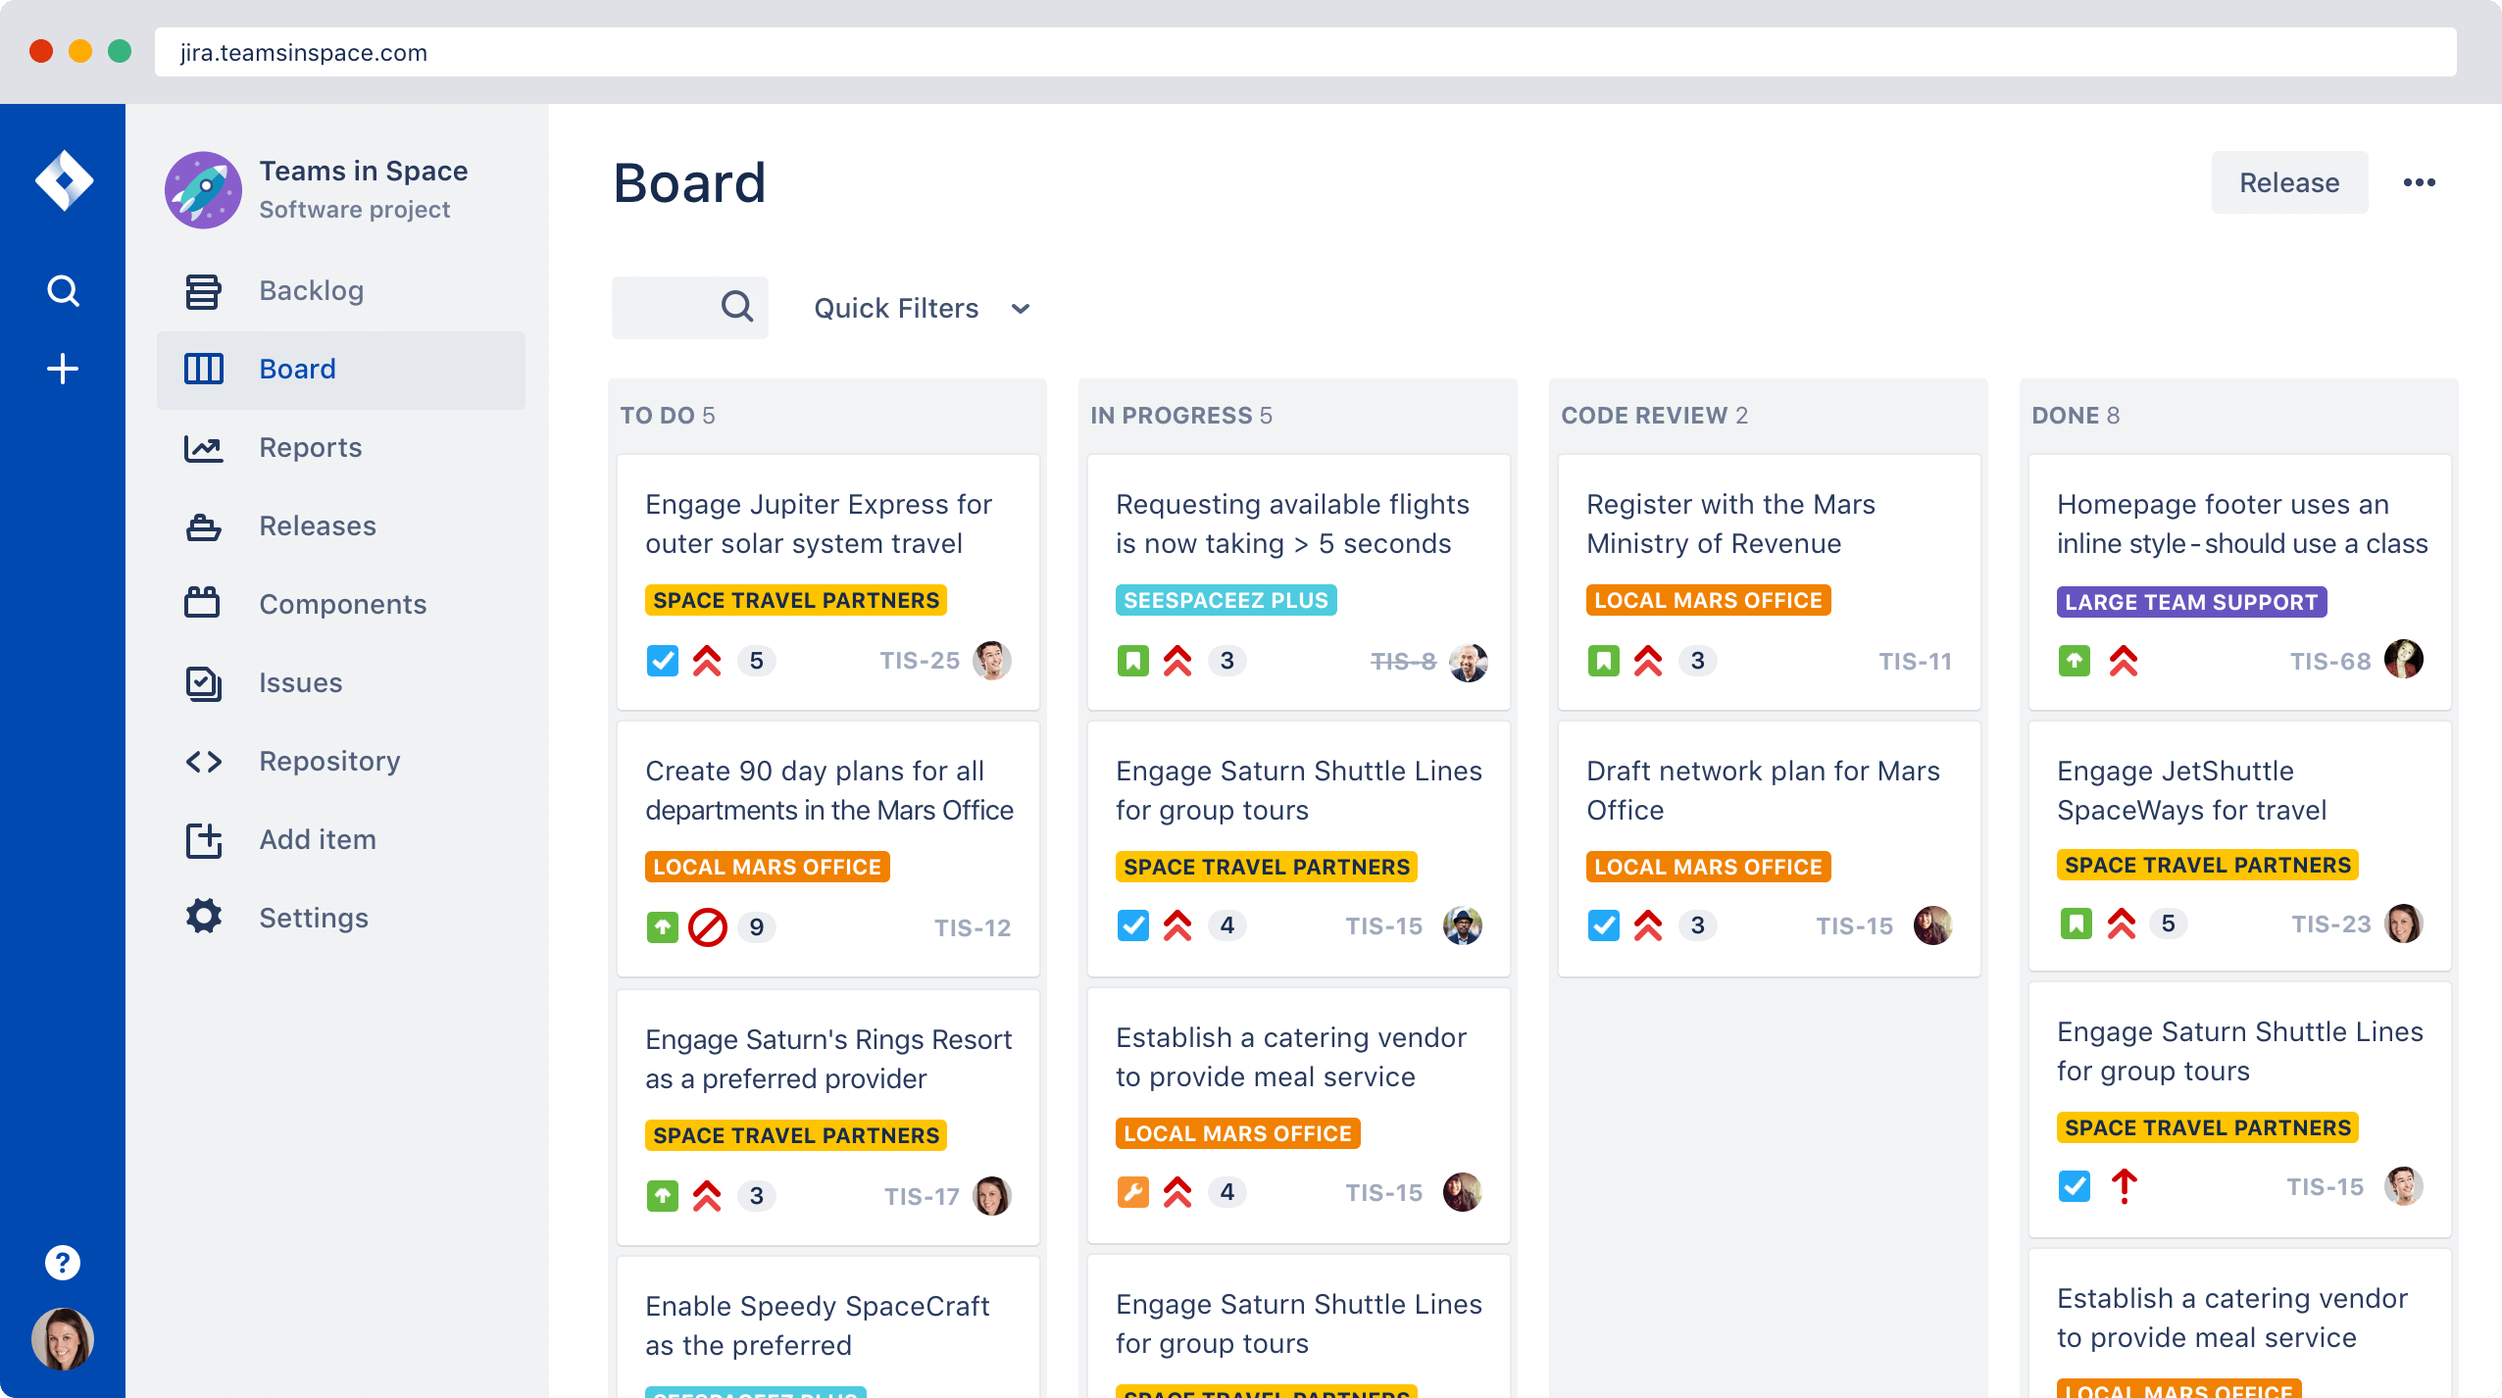
Task board example from Jira

Slide 29
Upcoming

Slide 30
Next time…
Wednesday is an extra work day

Slide 31
Reminders
Keep working on Project 4

